Slide 1

Practicum: CCI Training center
Jose Patino-Ramirez

Slide 2
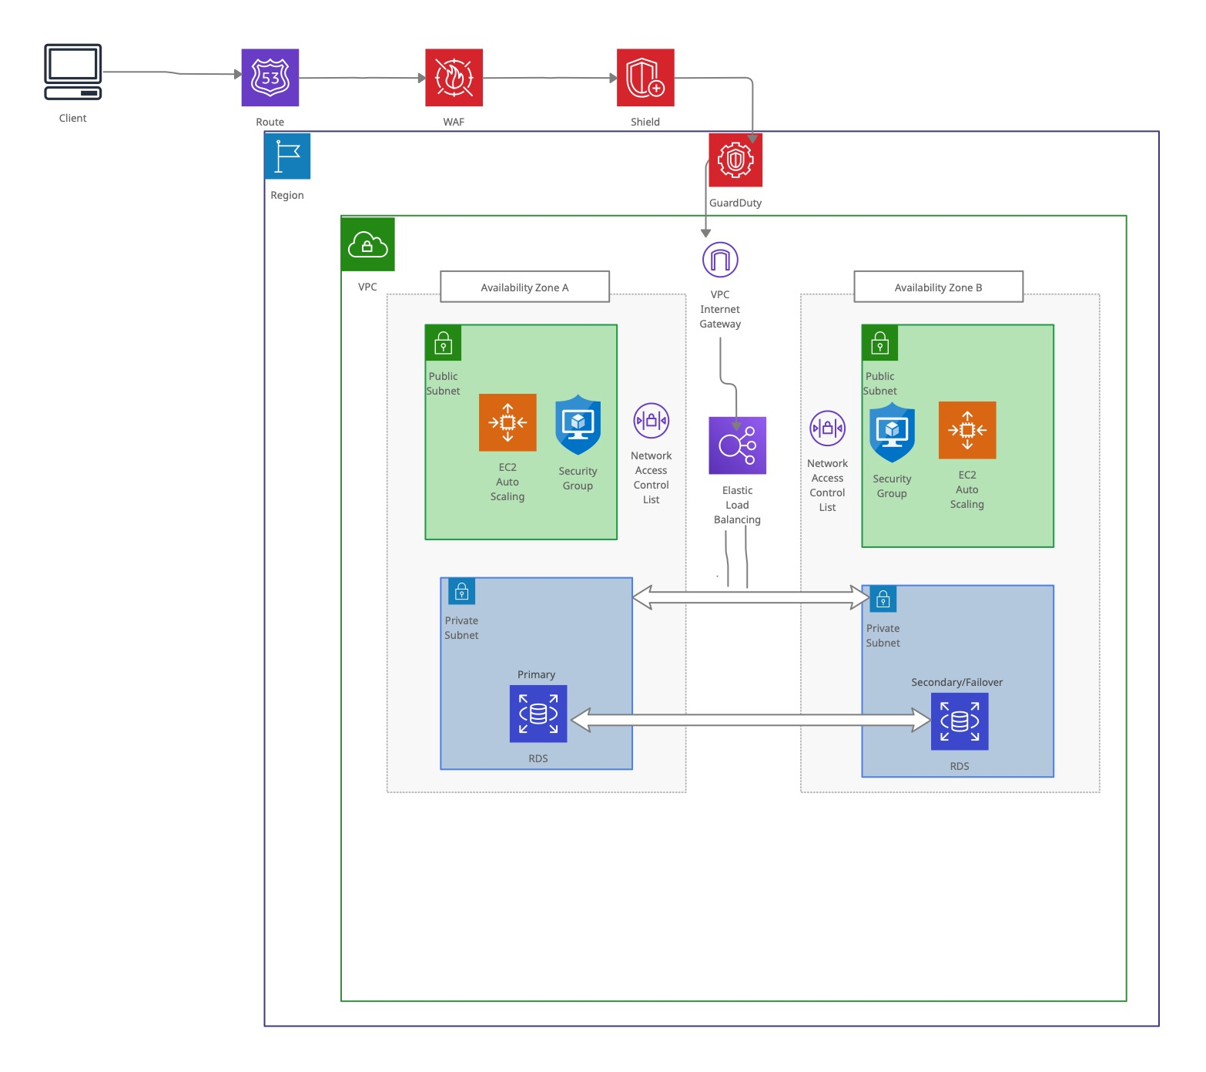

Slide 3
How to Protect your network
When a user makes a request, it can start by going to Amazon Route 53, which blocks malicious DNS queries
Next it will pass on to AWS WAF that protects against common web exploits that can compromise security and affect availability
Third going into AWS Shield which is always on detecting for any possible distributed denial of service attacks. AWS Shield can minimize application downtime and latency
Following into AWS GuardDuty which is continuously monitoring your AWS accounts, resources, and storage for potential threats. It can identify files containing malware and mitigate threats early by automatically responding to events
VPC Internet Gateway is redundant and highly available that allows you to communicate between your VPC and the Internet. It doesn’t cause bandwidth constraints on your network traffic

Slide 4
How to Protect your network (Continued)
The elastic load balancer distributes incoming application traffic across multiple targets. This helps protect the network by making sure no resources are being overused
You want to split your front-facing applications into public subnets that you want your customers to access, while keeping your back-end applications safe in private subnets
Placing network access control lists outside of the subnet so you can set rules on what traffic you want to allow in or out
Like NACLs, creating security groups for your EC2 instances so they act like virtual firewalls to control incoming and outgoing traffic
Having a multi-availability zone deployment protects your network by preventing a single point of failure. It helps provide redundancy in case something fails or there is an outage

